Slide 1

Agile Modeling: Effective Software Design
Agile modeling is a powerful approach to software design that focuses on rapid prototyping and iterative refinement, prioritizing collaboration and adaptability.
PRESENTED BY: UMAR ISLAM
ID:F2023266112

Slide 2

Key Principles of Agile Modeling
Focus on Value
Just Enough
Prioritize modeling elements that directly contribute to delivering value to stakeholders.
Create only the necessary models to support the current iteration of development.
Simple and Clear
Adaptive and Iterative
Use clear and concise models that are easily understood by everyone involved.
Models are constantly refined and updated based on feedback and changing requirements.

Slide 3
Modeling Techniques in Agile Environments
User Stories
Domain Modeling
Class Diagrams
Sequence Diagrams
Capture user requirements in simple, concise stories, focusing on functionality and value.
Visualize the key concepts and relationships in the business domain to improve understanding and communication.
Illustrate the structure of the software system, including classes, attributes, and relationships.
Show the interaction between different objects in the system, providing a clear view of the workflow.

Slide 4

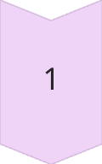
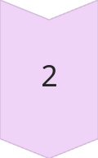
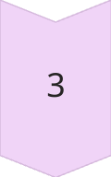
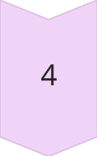
Stakeholder Collaboration and Feedback
Gather Requirements
Work closely with stakeholders to understand their needs and expectations.
Model and Prototype
Create models and prototypes to visualize and validate design decisions.
Iterative Feedback
Regularly share models and prototypes with stakeholders to receive feedback and refine the design.
Adapt and Improve
Incorporate feedback and adjust models and prototypes to meet evolving requirements.

Slide 5
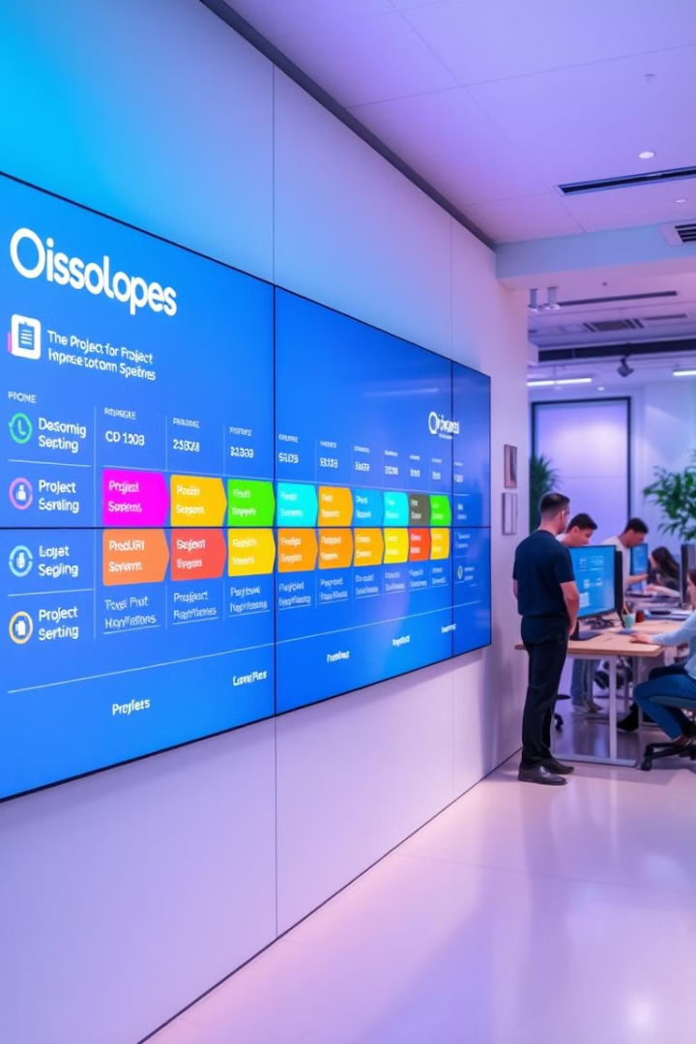




Adaptive Planning and Iterative Development
Sprint Planning
Iterative Development
Define clear goals for each sprint, focusing on delivering a specific set of features.
Build software in small, incremental steps, incorporating feedback and making adjustments along the way.
Continuous Integration
User Acceptance Testing
Regularly merge code changes to ensure a consistent and stable codebase.
Involve users in testing to ensure that the software meets their needs and expectations.

Slide 6





Effective Documentation Strategies
Living Documentation
1
Keep documentation updated in real time, reflecting the latest changes in the software.
2
Concise and Focused
Prioritize essential information, avoiding unnecessary details or redundancy.
3
Collaboration and Shared Ownership
Encourage all team members to contribute to and maintain documentation.
4
Version Control
Use version control systems to track changes and maintain a history of documentation.
5
Accessible and User-Friendly
Ensure that documentation is easily accessible and understandable for all stakeholders.

Slide 7

Continuous Improvement and Refactoring
1
Code Reviews
Regularly review code for quality, maintainability, and adherence to best practices.
2
Refactoring
Improve the design and structure of the software without changing its functionality.
3
Retrospectives
Regularly reflect on the process and identify areas for improvement.
4
Knowledge Sharing
Share best practices, lessons learned, and technical knowledge within the team.

Slide 8

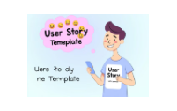
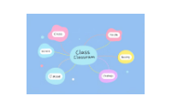
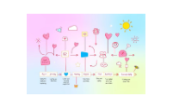
Integrating Agile Modeling into your Workflow
Agile modeling is a valuable tool for improving software design and development. By adopting these principles and techniques, you can enhance collaboration, adaptability, and quality.

Slide 9
LINKS:
https://agilemodeling.com/
https://en.wikipedia.org/wiki/Agile_modeling
https://www.geeksforgeeks.org/software-engineering-agile-development-models/
https://www.javatpoint.com/software-engineering-agile-model

